Slide 1
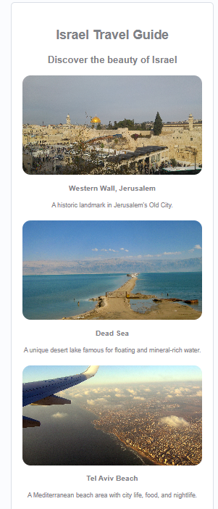
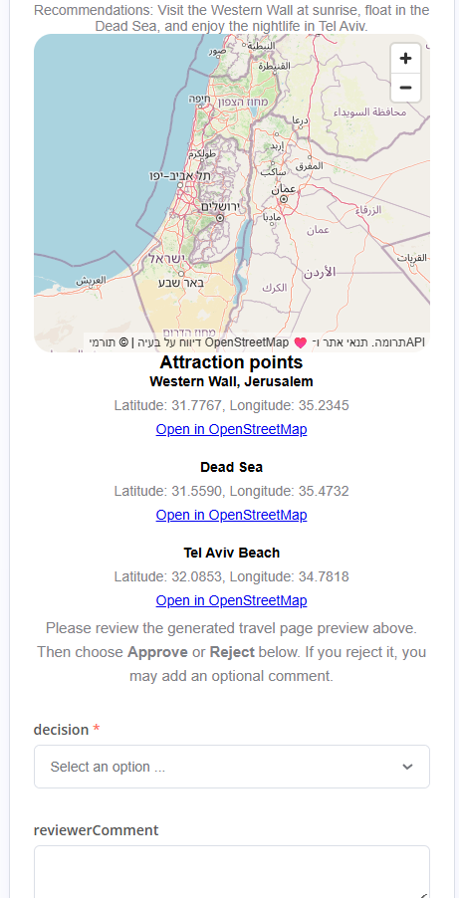
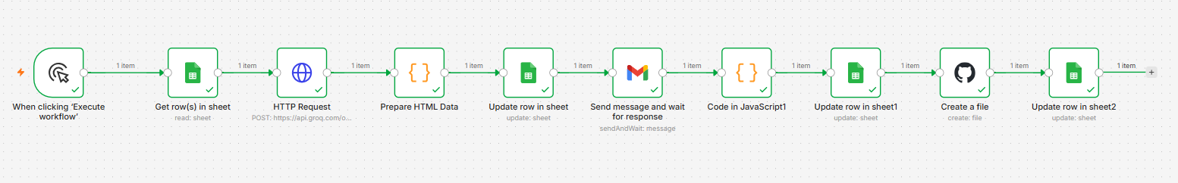
Exercise 3 - n8n Travel HTML Automation
Submitters: Maor Mordo & Daniel Grigoriev
Google Sheets input → Groq HTML generation → Gmail approval → Google Sheets + GitHub backup
Free AI model: Groq API • Local n8n with Docker • Manual run for stable classroom testing
n8n workflow
Example of the page that is sent
Tester setup
Each node performs one clear step in the automation chain.
Read the guide to start up the project in your own environment and reconnect your credentials after importing the workflow JSON and the other files:
01
Google Sheets
Read first row where Status = Pending
● Google Sheets OAuth2
02
Groq Free
● Groq API Key
Generate GeneratedHtml + ReviewHtml
03
Gmail
● Gmail OAuth2
Send approval/rejection form to tester
● GitHub Token
04
Decision
Run mode
Approve or Reject with optional comment
Manual Trigger is recommended for the demo. A Schedule Trigger may be added for automatic polling.
05
Sheets + GitHub
Save final status, link and backup file
Exercise 3 submission slide
Maor Mordo • Daniel Grigoriev

